Slide 1


Analyzing Amazon Sales data
Project 1

Slide 2
Introduction
Problem Statement:
Sales management has gained importance to meet increasing competition and the need for improved methods of distribution to reduce cost and to increase profits. Sales management today is the most important function in a commercial and business enterprise.
Do ETL: Extract-Transform-Load some Amazon dataset and
find for me Sales-trend -> month-wise, year-wise, yearly_month-wise
Find key metrics and factors and show the meaningful relationships between attributes.
Do your own research and come up with your findings.

Slide 3
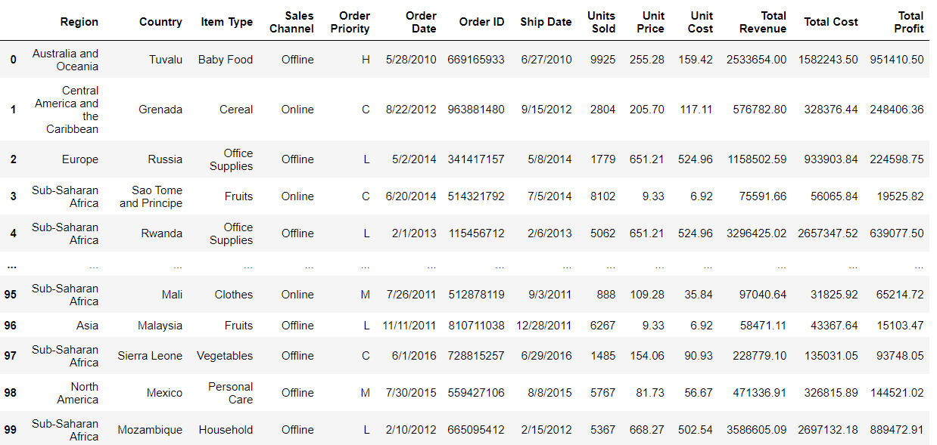
Amazon sales analysis
Amazon Sales data preview:

Slide 4
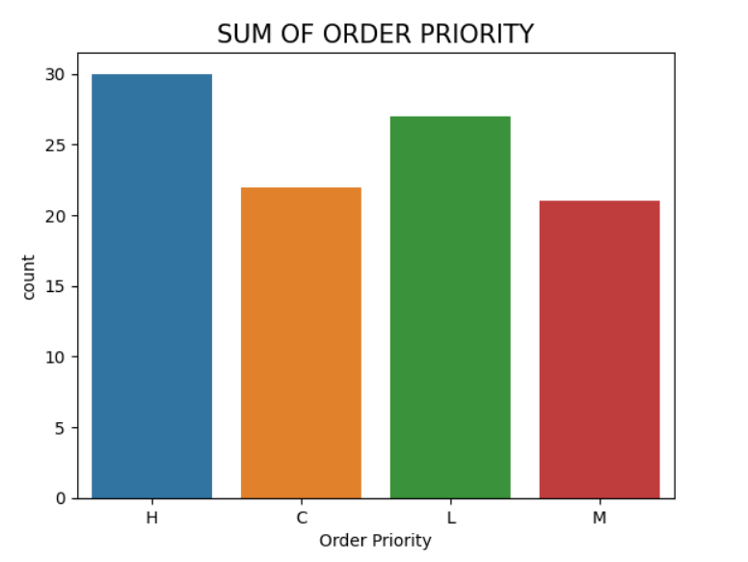
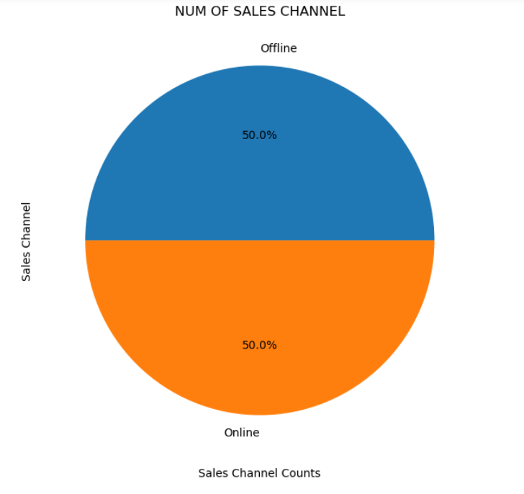
Amazon sales analysis
Sum of order priority & Number of sales channel:
Order priority category ‘H’ is highly distributed
Sales channel offline & Online is equally distributed

Slide 5
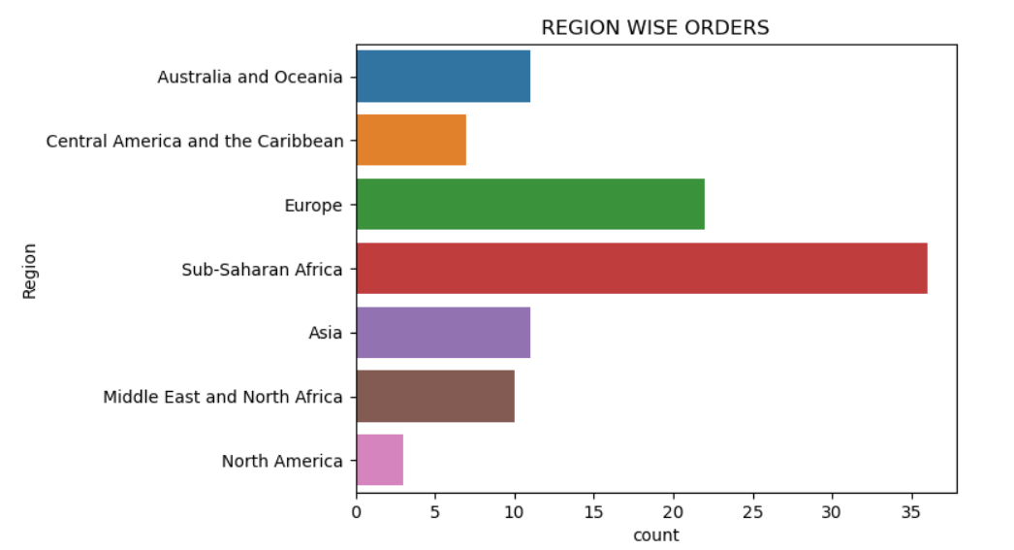
Amazon sales analysis
Region wise orders:
Region Sub-Saharan Africa is having higher order count

Slide 6
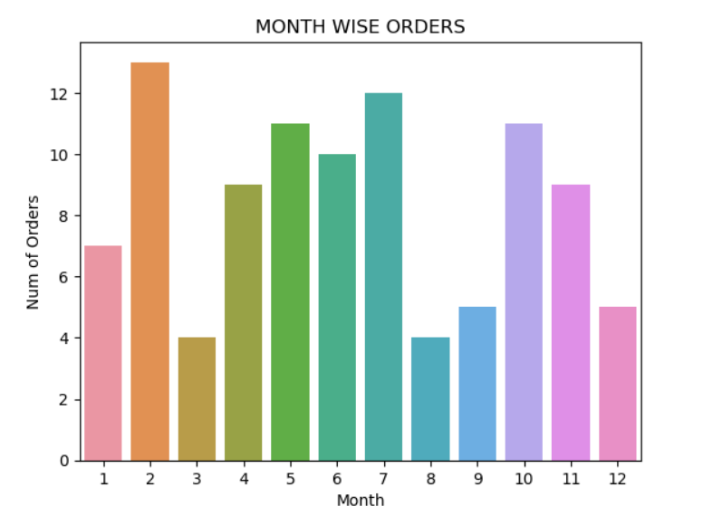
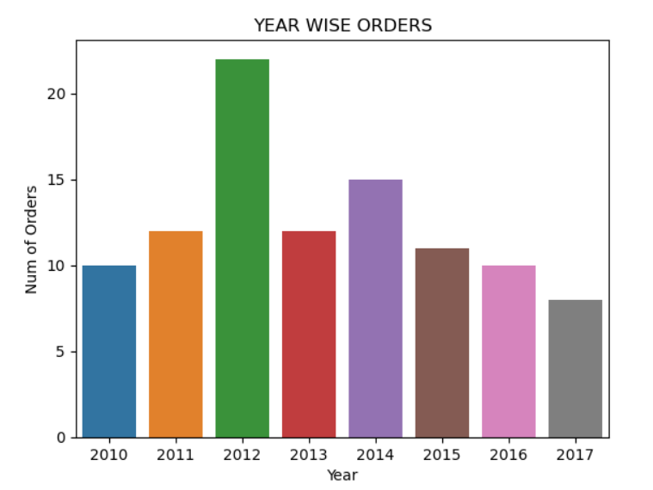
Amazon sales analysis
Month & Year wise orders:
Month – February is having higher orders
In the Year 2012 the order is highly distributed.

Slide 7
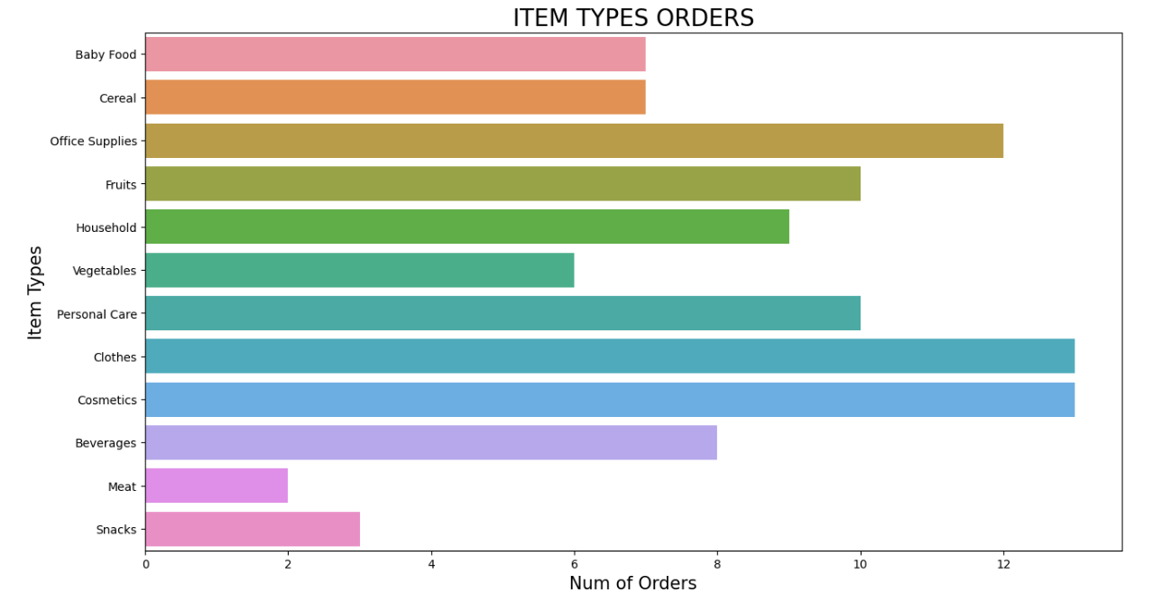
Amazon sales analysis
Number of item type orders:
Item types number of orders clothes and cosmetics are highly distributed

Slide 8
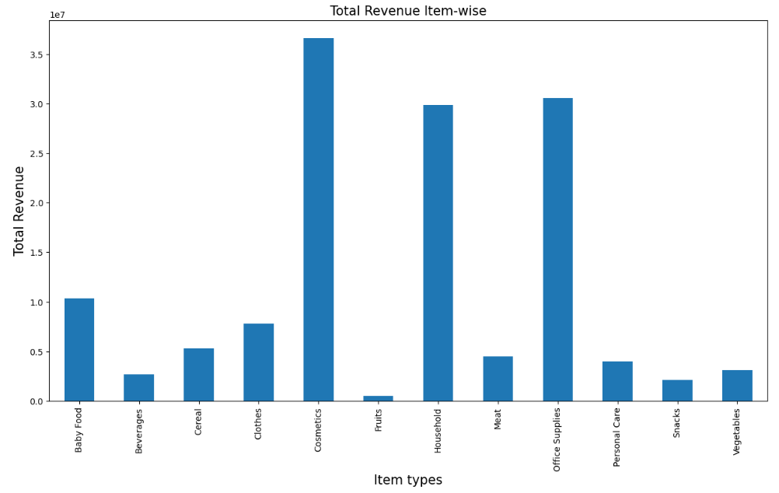
Amazon sales analysis
Total revenue Item type wise:
Total revenue in item category cosmetics is highly distributed.

Slide 9
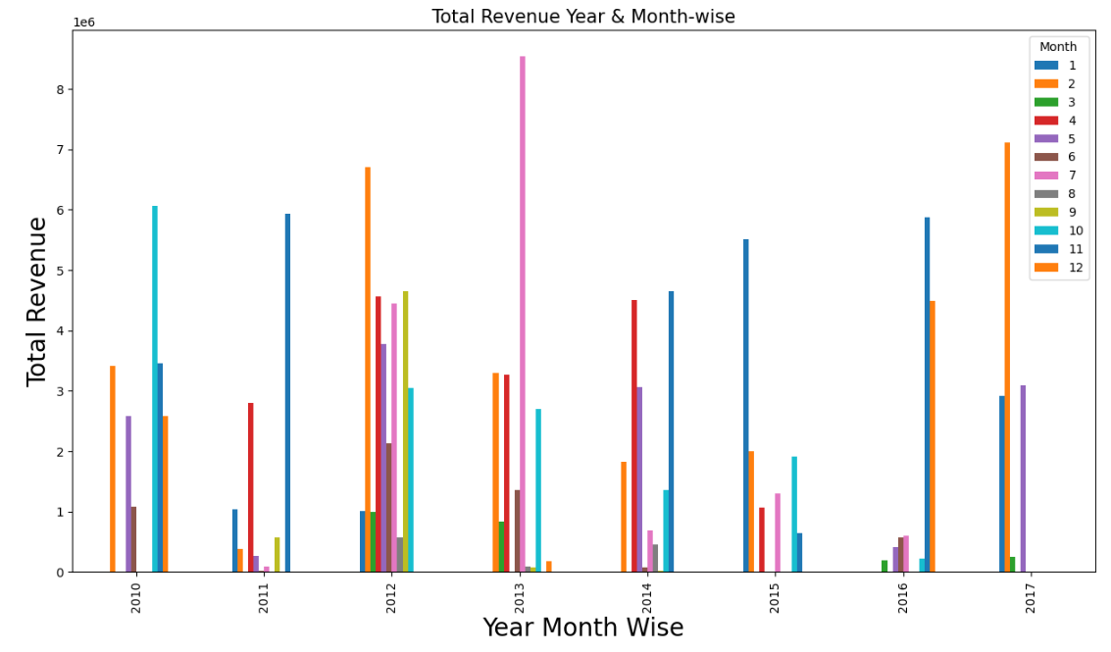
Amazon sales analysis
Total revenue Year & Month wise:
From 2010 to 2017 total revenue distribution year & month wise.

Slide 10
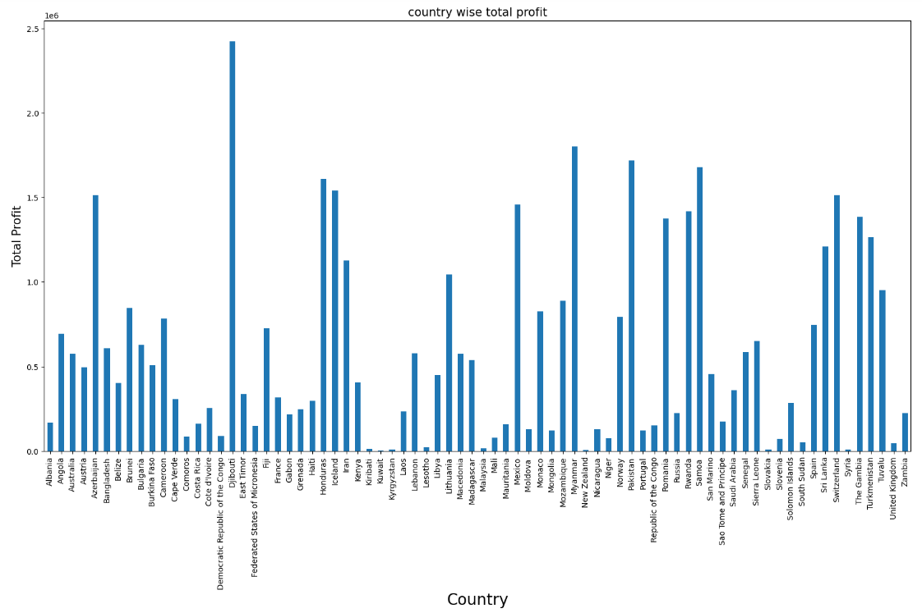
Amazon sales analysis
Total profit in country wise:
Total profit is highly distributed in Dijibouti country.

Slide 11
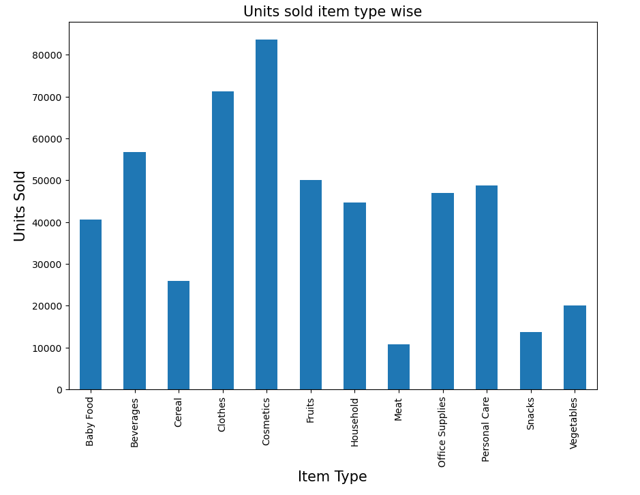
Amazon sales analysis
Unit sold with item type wise:
Item type cosmetics units is highly sold.

Slide 12
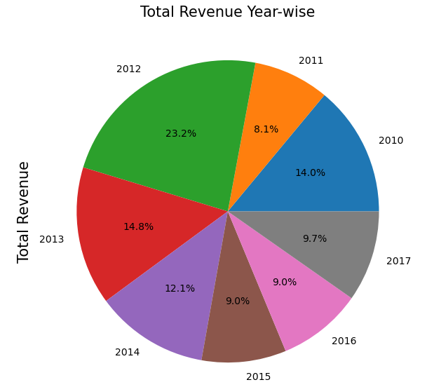
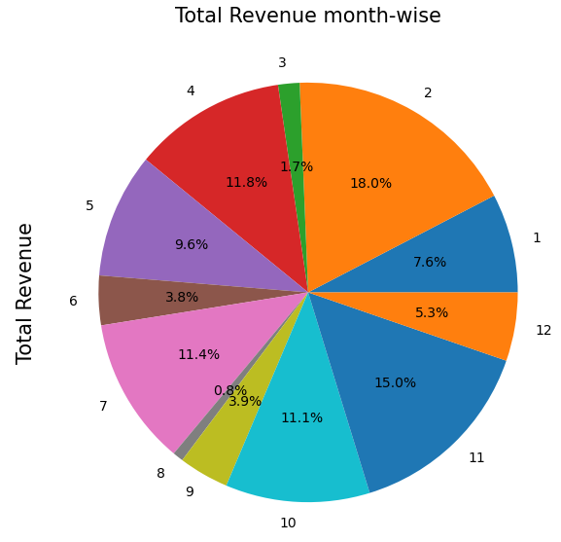
Amazon sales analysis
Total revenue Year & Month wise:
Total revenue is highly distributed in the year 2012 (23.2%).
Total revenue is highly distributed in the month of February (18%)

Slide 13
Thank You

